Slide 1
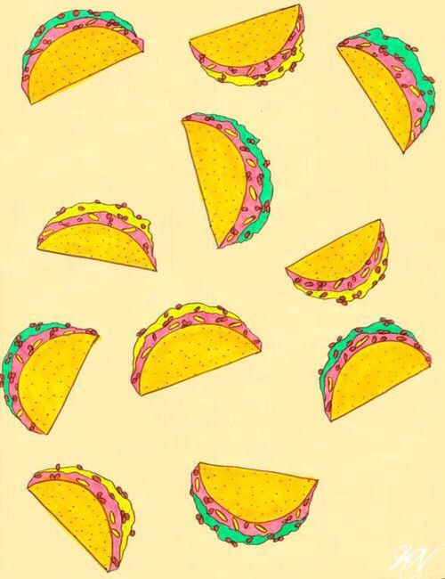
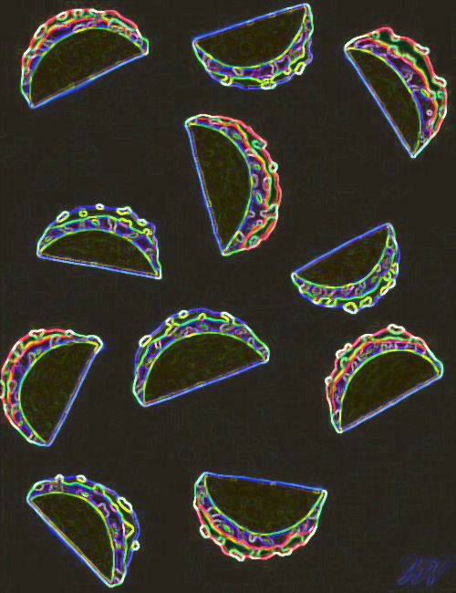
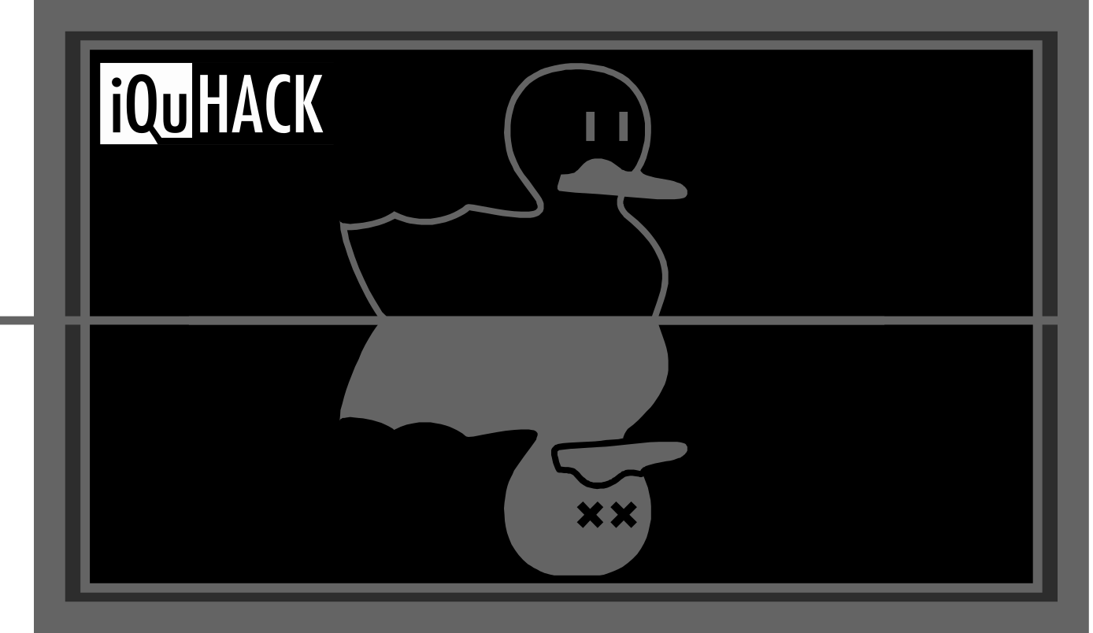
TaQu Fever
~ QTacos ~
Yareli Aguilar, Alejandro Martínez, Diego Pérez, Isaac Pimentel, Saúl Puente.

Slide 2
Synopsis

Slide 3
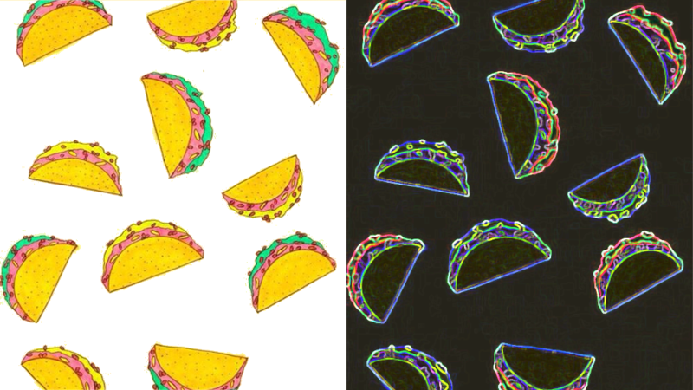

It's food time and everyone wants to eat at QTacos!
Take orders and make the perfect taco by using awesome quantum gate ingredients!
In TaQu Fever you are the Master Taquero, who has to recreate what customers order.
Notes:
It's food time and everyone wants to eat at QTacos!Take orders and make the perfect taco by using awesome quantum gate ingredients!In TaQu Fever you are the Master Taquero, who has to recreate what customers order.

Slide 4
Goals

Slide 5
We want TaQu Fever to be:
A fun and entertaining quantum game.
Educational for the user: by learning quantum algorithms as ingredients of the QTaco and seeing how they change the initial quantum state (QTortilla).
Motivational and exciting for the user.
Notes:
We want TaQu Fever to be a fun and entertaining quantum game, but also, we want the user to be capable of use and create quantum algorithms, as well as learn about quantum gates and it's effects on the quantum states. By making QTacos, the user, seeing how any ingredient (quantum gate) changes the initial state, adquires experience and motivation to keep making QTacos and do it as fast as he cans to break his own record. With all this, we can say that TaQu Fever is an useful entertaining game with all the posibility to be educational to the user, and also is about delicious quantum food.

Slide 6
Basic Principles

Slide 7
Programmed entirely in Python.
Quantum part of the program in Qiskit.
3 core elements: customer’s order, QTaco ingredients, way to prepare QTacos.
The customer order is generated by creating a small random quantum circuit of 5 gates in 3 qubits. The result of simulating such a circuit is presented with the percentages that we would expect to find in a series of measurements in a quantum processor.
After preparing the order of cues, they are verified to match by running the quantum circuit in a simulator or on a real quantum processor.
Notes:
Our game was programmed entirely in Python. The quantum part of the program was programmed in Qiskit. The game has three core elements: the customer's order, the taco ingredients and the way to prepare the tacos. The customer order is generated by creating a small random quantum circuit of 5 gates in 3 qubits. The result of simulating such a circuit is presented with the percentages that we would expect to find in a series of measurements in a quantum processor.The possible tacos ingredients are the possible quantum gates, which in this case we use only five gates: Hadamard, X, Y, Z, CNot.Each taco represents a qubit in a quantum circuit that the user has to prepare so that the result resembles (with an error tolerance) the one shown in the order.After preparing the order of cues, they are verified to match by running the quantum circuit in a simulator or on a real quantum processor.

Slide 8
Elements and instructions

Slide 9
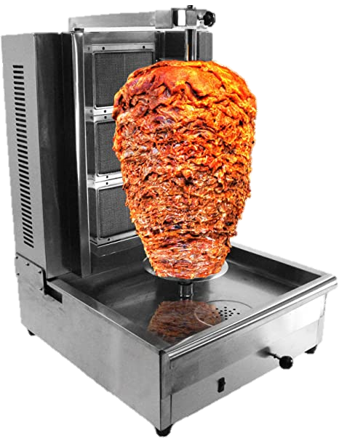

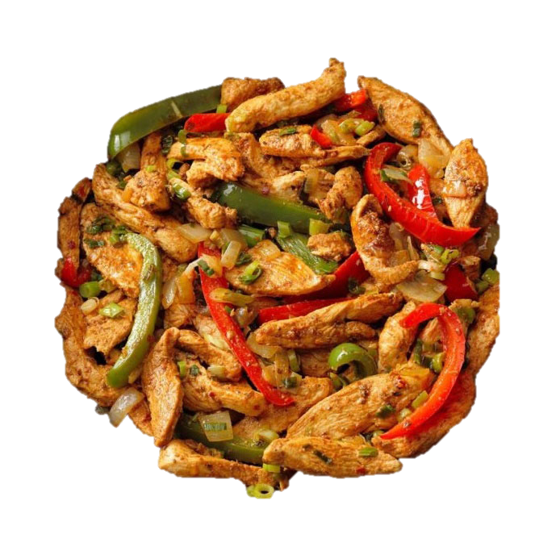
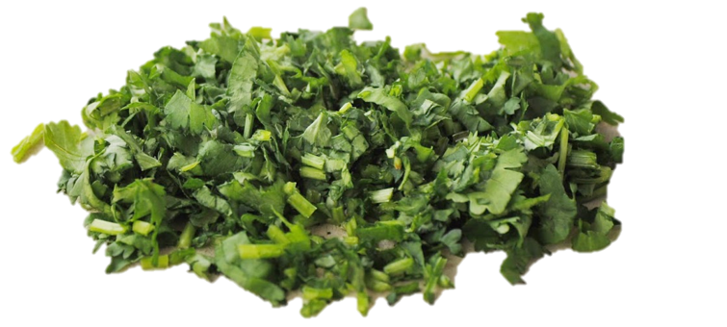
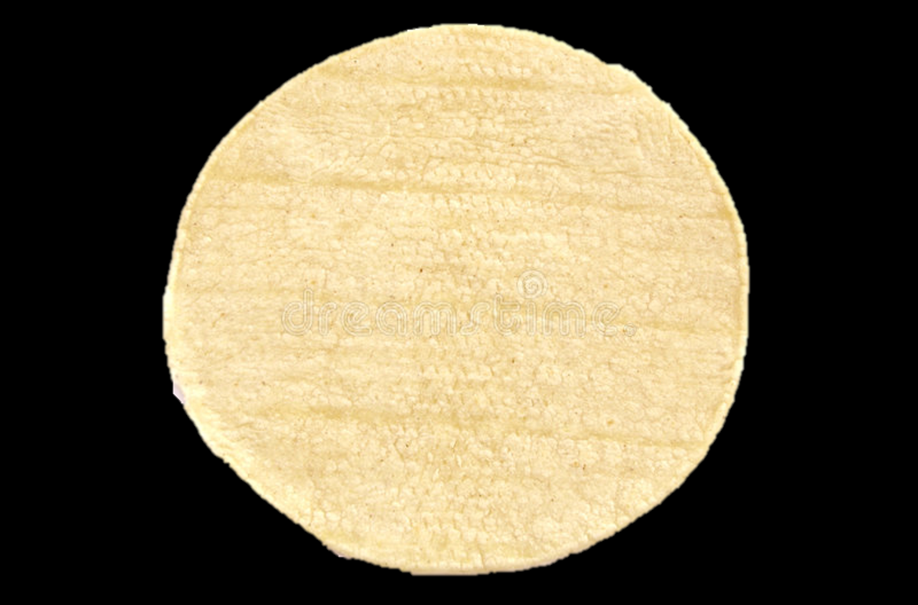
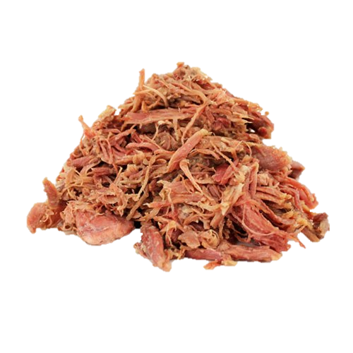
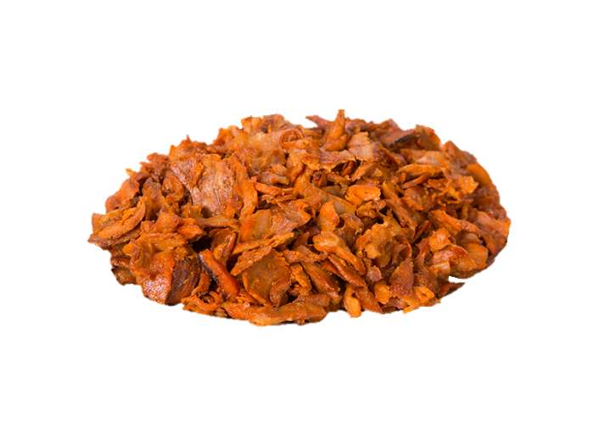


Ingredients
Zilantro - Z
Xicken - X
A
QTortilla – Initial Quantum State
DesHebrada - H
OnYon - Y
Pasnot - CX

Slide 10
How to make a Qtaco?
Start with a QTortilla, which is a qubit in an initial quantum state, apply different ingredients made of quantum gates, and what you get is an awesome QTaco, which you can see as a qubit in a final quantum state. If this QTaco is the QTaco the customer ordered, you win one point.
Notes:
You start with a QTortilla, which is a qubit in an initial quantum state, then you apply different ingredients made of quantum gates, and what you get is an awesome QTaco, which you can see as a qubit in a final quantum state. If this QTaco is the QTaco the customer ordered, you win one point. Don't forget this is a time trial game! What will be your highest record?

Slide 11
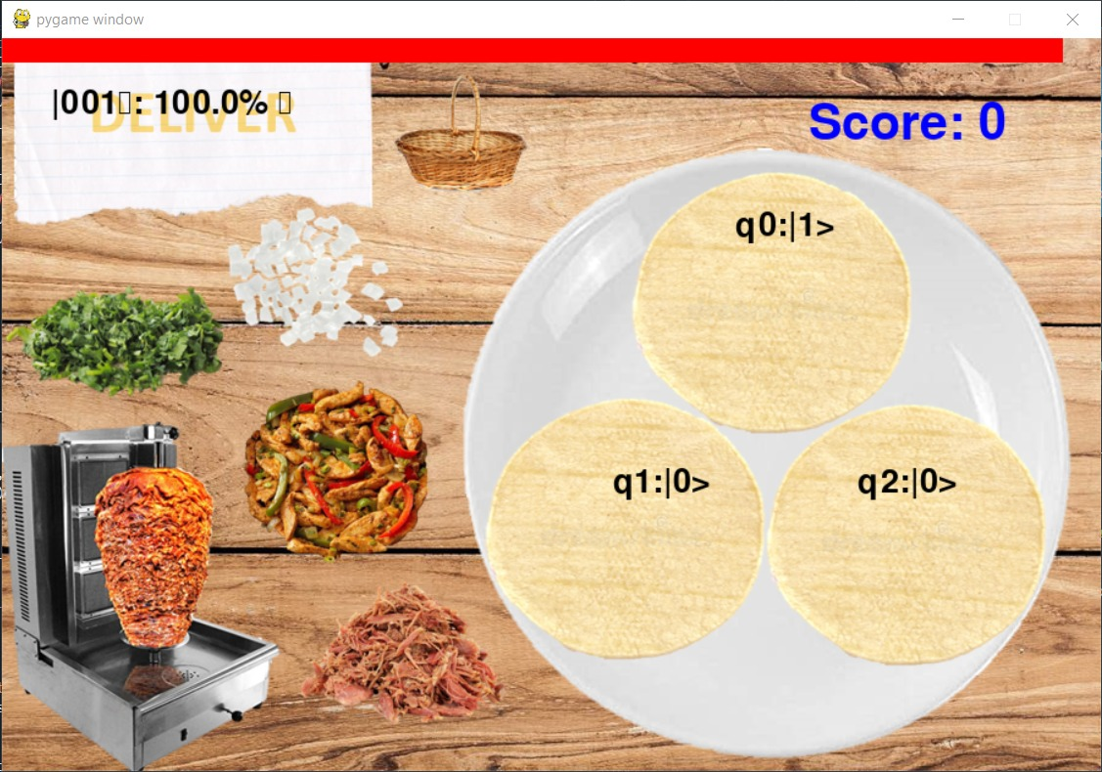
How to play the game?
Order
Basket
The player start with 3 Qtortillas.
The order from the customer tells him the QTaco he wants.
The player must make the correct QTaco to win.
When the time is over the player can set his record.
QTortilla
Ingredients
Notes:
The player will start with 3 QTortillas in a plate. As we explained in the synopsis, each QTortilla has an initial quantum random state, which the user can see. The player will be recieving orders from the customers, that indicate the final state they want to have (the QTaco represented as a quantum state). The user has to build the QTacos according to the specification the customer asks for, and obtain the expected quantum state of the QTaco. Each ingredient applies a different gate to the quantum state. Once you put an ingredient to the taco, you cannot erase it. You win a point whenever you get the correct QTaco. Since it's a time trial game, you will have 60 seconds to complete as much correct QTacos as you can (you can also set the time limit).

Slide 12
Demostration

Slide 13
ToDo

Slide 14
Proposals for future work:
Better graphics.
More difficulty modes.
More variation of ingredients (quantum gates).
Variable screen size and fullscreen implementation.

